Slide 1


National Semiconductor Corporation (NSC)
Case study and analysis

Slide 2
National Semiconductor Corporation (NSC) background
National Semiconductor Corporation (NSC) established the India Design Center (IDC) in Bangalore, India, as part of its global strategy for cost-effective design and development.
Founded in 1995, IDC initially operated as a support center focused on customizations, quality assurance, and validation tasks.
By 2002, IDC had grown significantly and shifted to complex projects, aiming to develop complete System-on-Chip (SOC) solutions for consumer electronics like cell phones and audio devices.
This transformation required the IDC to not only perform specific project components but also take ownership of end-to-end product development

Slide 3
Key Stakeholders
1. Ashok Kumar: The general manager of IDC, responsible for overseeing operations, growth, and team management at IDC.
2. IDC Management Team: -
Sonali De Sarker: Manager of Human Resources, managing recruitment, retention, and HR policies.
Sanjay Sood: Manager of Finance, responsible for budget management and financial reporting.
Krishna Moorthy: Senior Engineering Manager, overseeing technical aspects of SOC projects.
Other Engineering Managers:
Such as Dr. Partha Ray, joining to lead the CAD software group, and expected hires like Ravi Perumal.
3. NSC Headquarters (Santa Clara): This includes Tom Jones, Ashok’s direct superior and the director of NSC's global design centers. Headquarters in Santa Clara is responsible for resource allocation, performance evaluation, and setting project priorities for IDC.

Slide 4
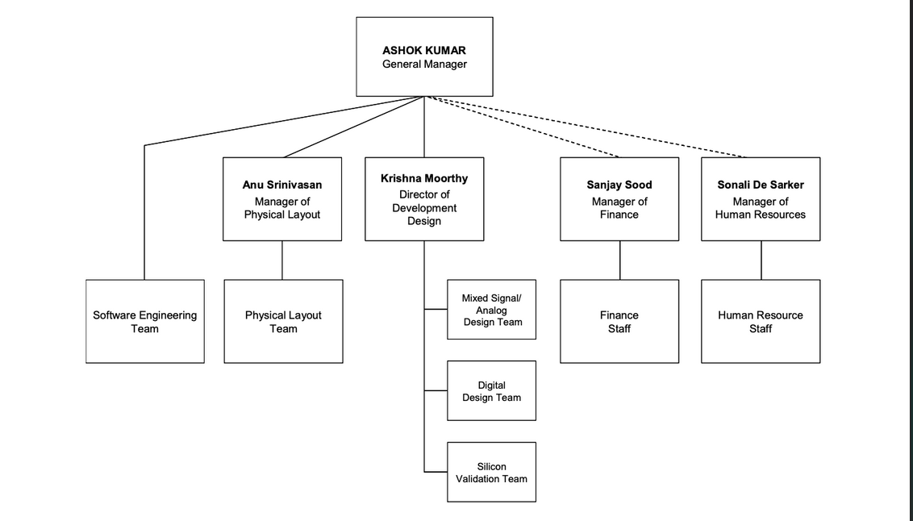
structure

Slide 5
Problems Faced
Talent Acquisition and Retention: Difficulty attracting and retaining skilled talent in Bangalore’s competitive market.
Team Dynamics: Need for better coordination and conflict resolution among team members.
Transition to Product Ownership: Moving from task-based to complete product ownership.
Complex Reporting Structures: Multiple reporting lines creating confusion in priorities.Alignment with Corporate Standards: Integrating IDC’s practices with those at headquarters.
Maintaining Cohesion During Growth: Ensuring trust and collaboration as the team expands.
Budget Constraints: Managing limited resources while meeting technical demands

Slide 6
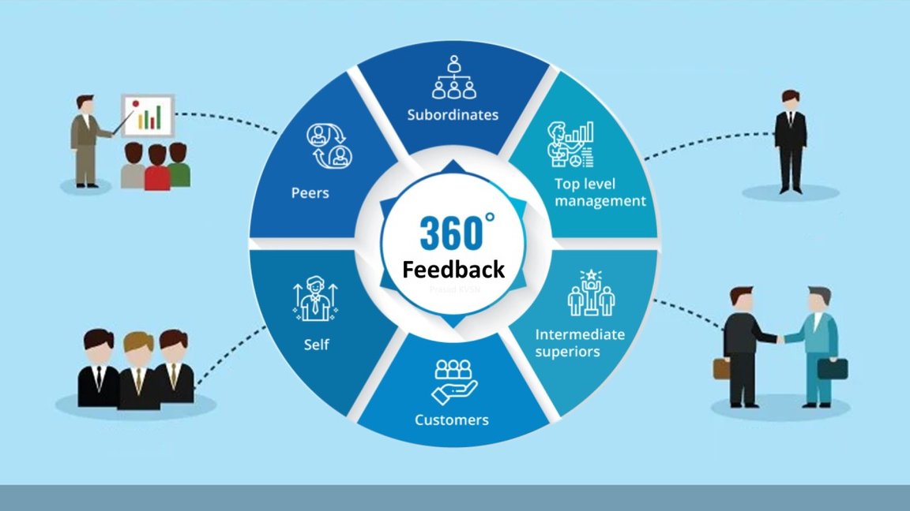
Solutions suggested by stakeholders
Various solutions were proposed by IDC’s leadership and other stakeholders to address these challenges:360-Degree Feedback Process:
IDC adopted a 360-degree feedback mechanism to foster self-awareness and transparency. Feedback from peers, supervisors, and subordinates helped team members identify areas of improvement, enhancing interpersonal relationships and mutual respect.

Slide 7
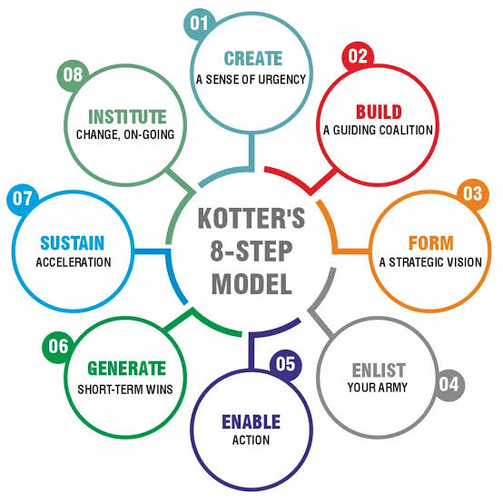
Solutions suggested by stakeholders
Enhanced Communication Channels: Weekly management meetings were introduced to improve communication and collaboration among different functional heads, facilitating better conflict resolution.
Leadership Development: Training and development sessions were implemented to equip managers with better leadership skills and foster a cohesive team environment.
Structured Integration for New Managers: Socialization activities, developmental sessions, and team-building exercises were suggested to help new members assimilate into the existing team culture.

Slide 8
Suggested Solutions
Incorporating Interpersonal and Intrapersonal Skill Development: Establish regular training sessions focusing on emotional intelligence and conflict resolution to help team members communicate more effectively and manage their own responses in high-stress situations.
Leadership Roles and Development: Implement mentorship programs within IDC to develop emerging leaders and empower them to resolve conflicts independently. Assigning specific responsibilities that allow managers to exercise leadership could build confidence and reduce dependency on upper management for conflict resolution.
Conflict Resolution: Encourage an open feedback culture where team members can voice concerns in a constructive way. Instituting a peer mediation program can help resolve minor issues before they escalate
Managing Change: With each addition to the team, conduct a structured onboarding program that incorporates both technical and cultural training, emphasizing IDC’s values and expectations.

Slide 9
Conclusion
IDC’s Growth Vision: Transition to full product ownership and develop a cohesive, high-performance team.
Key Takeaways: Structured managerial processes and organizational behavior strategies can address IDC’s challenges, paving the way for sustainable growth.

Slide 10

Presented by
Puneet
Radhika
Renu
Rishik
Rishita
Sahil

